Slide 1
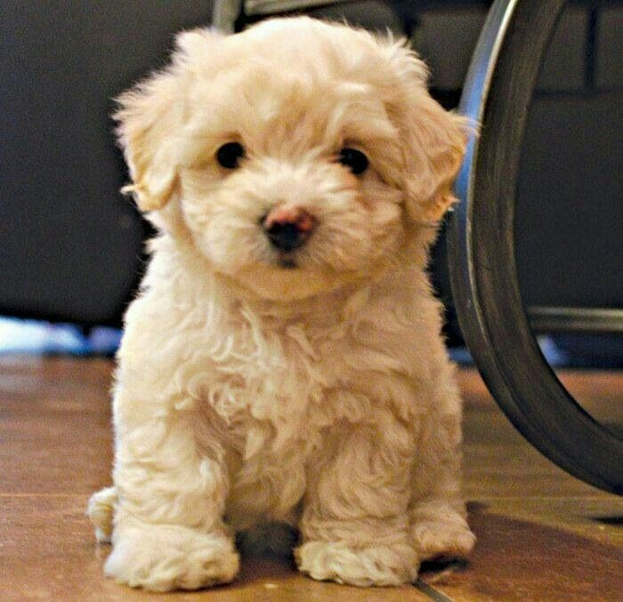
hello my name is Luz Almanza
my favorite animal is the dog, because they can protect you and love you, there very lovely and sweet, there lots of them . my favorite ones is the French poodles because is small and hairy .
they can be you´re best friend .my dogs color is beige he´s not so big ,he loves to play with the ball, and run all over the house . he´s a beautiful dog.

Slide 2
San francisquito
calendary

Slide 3
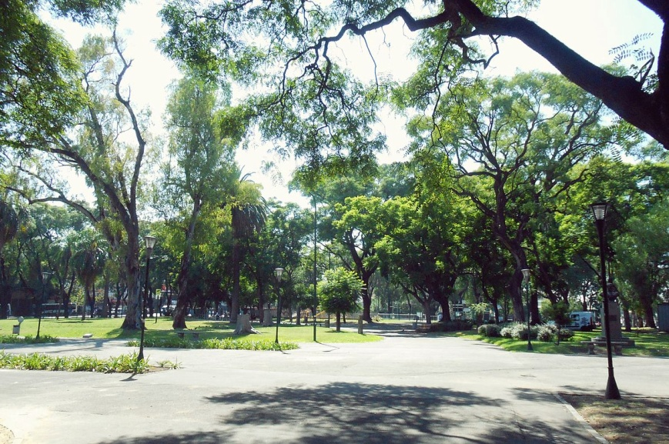
Principal park

Slide 4


Slide 5
Due to the growth of San
Francisquito, the town counts now
with a main road leading to the
capital of the country and a recognized
school. In addition, the bolus was added
criollo that, unlike the bolus
traditional, the ball goes through the air. Is
It has been one of the biggest
attractions that the
increase of tourists in the region.

Slide 6
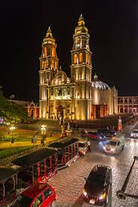
MAY

Slide 7
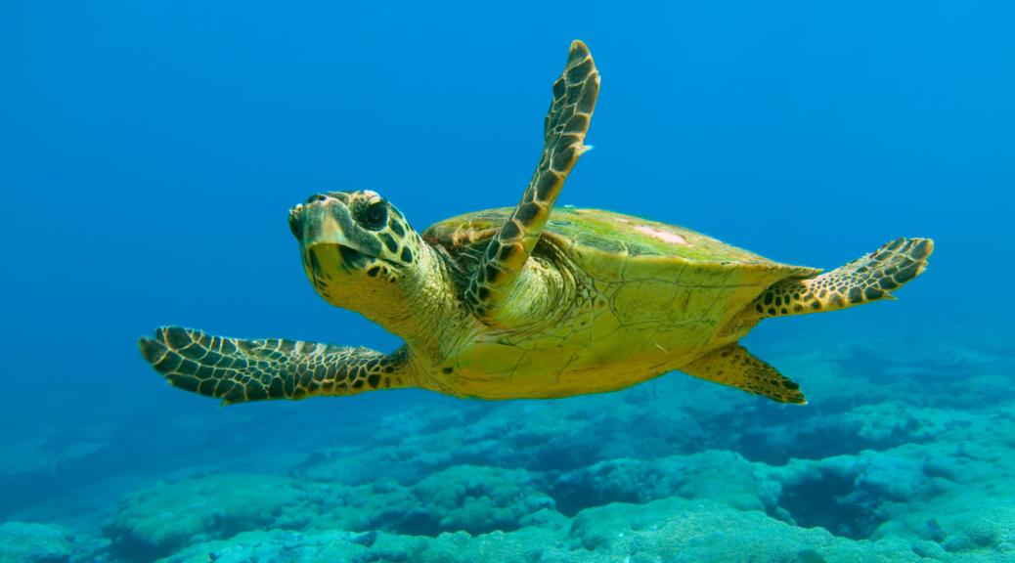
Month of reptiles

Slide 8
CUADRUPEDO HERVIVORO BODY MASS: CHELONIA MYDAS: 160 KG, TURTLE BOBA: 160 KG, LEPIDOCHELYS KEMPII: 40 KG THE SEA TURTLES HAVE AN UNINTERRUPTED GROWTH DURING THEIR WHOLE LIFE. AT BIRTH, THE TURTLES CAN WEIGH 50 G, IN A YEAR 2 KG, AT 3 YEARS 20 KG AND 300 KG IN MATURITY (14 YEARS). SEXUAL MATURITY ARE ACHIEVED BETWEEN 6 AND 15 YEARS OLD.

Slide 9
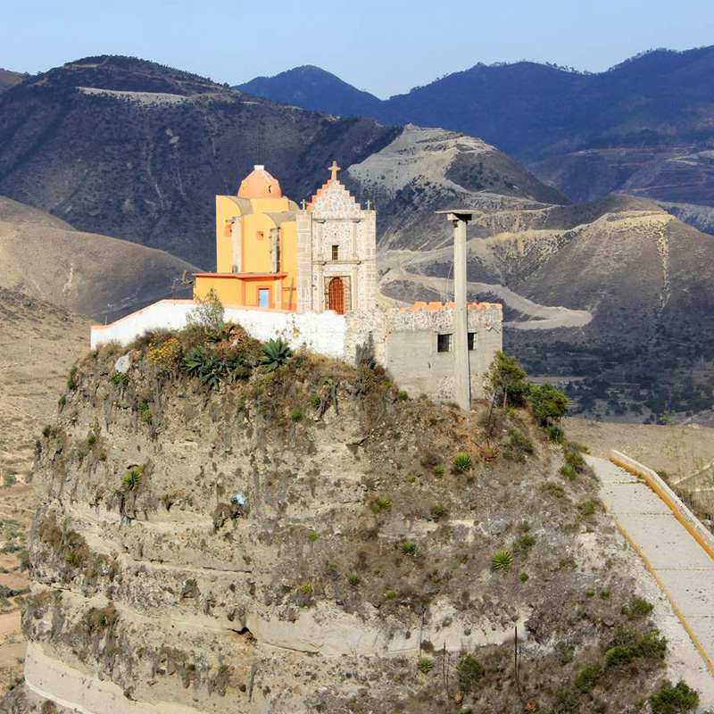
the village festivities in which games like tejo and frog are developed. an exhibition of dogs and horses is made next to the main cavalcade of the town

Slide 10


Slide 11
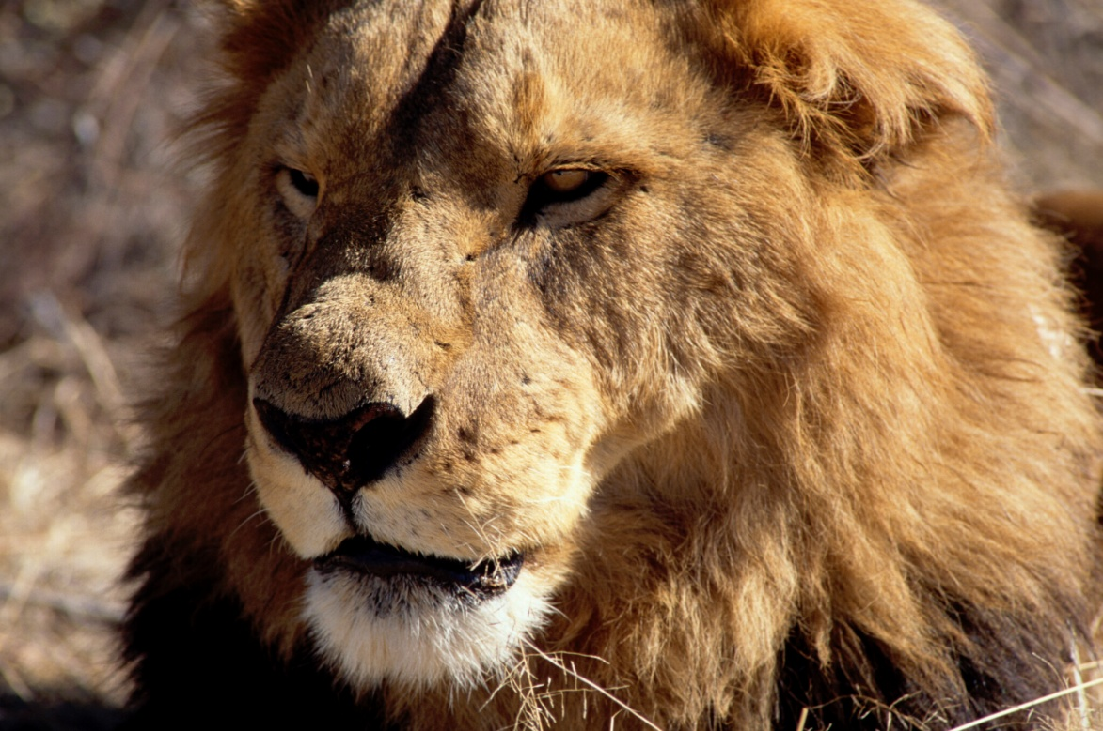
Month of the carnivores

Slide 12
LIONS: is a species in the family Felidae; it is a muscular, deep-chested cat with a short, rounded head, a reduced neck and round ears, and a hairy tuft at the end of its tail. The lion is sexually dimorphic; males are larger than females with a typical weight range of 150 to 250 kg (330 to 550 lb) for males and 120 to 182 kg (265 to 400 lb) for females. Male lions have a prominent mane, which is the most recognizable feature of the species

